Slide 1
Computational Properties of Neural Columns arising from Temporal Dynamics
Vincent Baker
Drexel University Department of Physics

Slide 2
Thesis
The big question: how does cognition arise from the biophysical organization of the brain?
Research question: Can columns of neurons encode time series inputs into high-order dynamic states that facilitate classification?
Research approach: Simulate neural columns in the liquid state machine computational model, measure the effects of physical properties on computational performance in classifying time series inputs

Slide 3
Impact
Deeper understanding of biological neural circuits
Creates new measures of computational capability for biological networks
Biologically plausible adaptation mechanisms
New understanding of the role of neural dynamics in cognition
Improved liquid state machines for machine learning
Improved computational properties inspired by biological neuron dynamics
Fast implementation on application-specific hardware

Slide 4
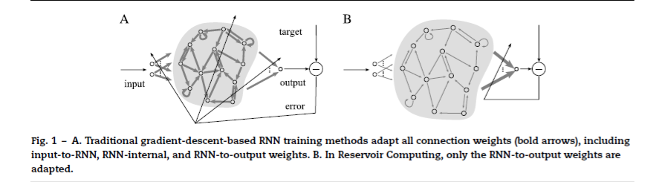
Liquid State Machines
Nonlinear “liquid” with fading memory is driven by an input
The input evokes complex dynamics in the liquid
A linear readout map extracts the desired data from the liquid
Lukosevicius and Jaeger 2009

Slide 5
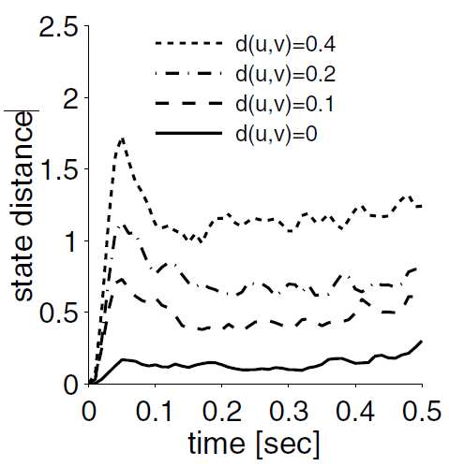
LSM: separation and approximation
The liquid state machine needs to separate distinct temporal inputs while associating similar inputs
The separation property can be characterized by injecting different spike trains
The liquid states should be farther apart for spike trains that are farther apart
This requires a distance metric for both spike trains and the liquid states, initial work used the L2 norm
The distance between liquid state trajectories reflects the distance between the input spike trains [Maas 2002]

Slide 6
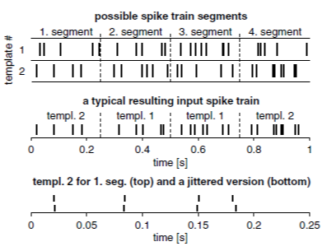
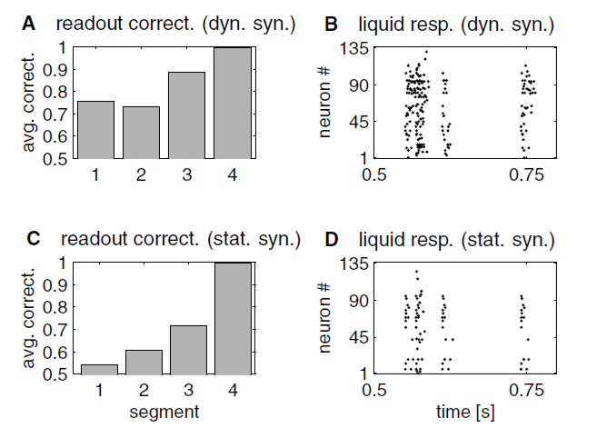
LSM: Fading memory
Maas et al showed that a reservoir with fading memory retains information about time history in its dynamic state
LSM was able to classify all 4 segments in a 1 second sequence based only on the liquid state at t=1 second
Fading memory created by dynamic synapses (right, top) can recognize past events in a time series. The network with static synapses (right, bottom) showed limited memory [Maas 2002].

Slide 7
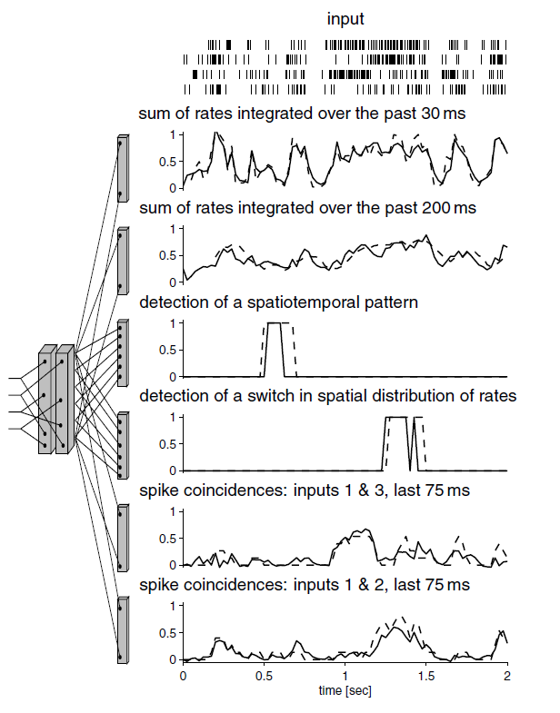
LSM: Multiple readouts
Multiple linear readouts can be trained to extract different information from a single reservoir
Simple adaptation mechanism for new information that does not disturb previously trained readout maps
Desirable property for adaptive learning where all classes are not known a priori
6 readouts extracting diverse information from the same reservoir for the same input. Actual values plotted as dashed lines, readout response are solid lines (Maas 2002)

Slide 8
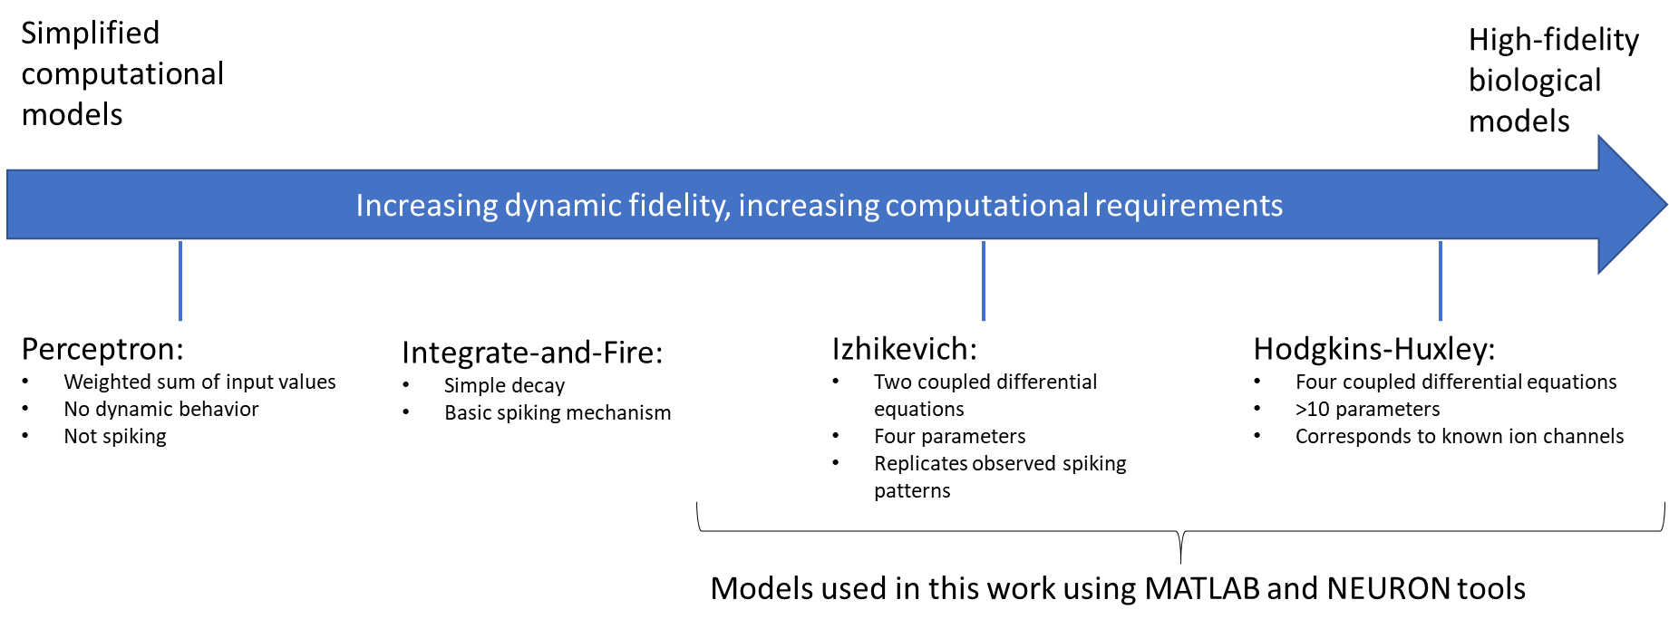
Neural models
Neural dynamics play an important role in temporal response
We start with the Izhikevich model, a simplified 2D dynamic system
Can explore nonlinear dynamics while retaining fast simulation

Slide 9
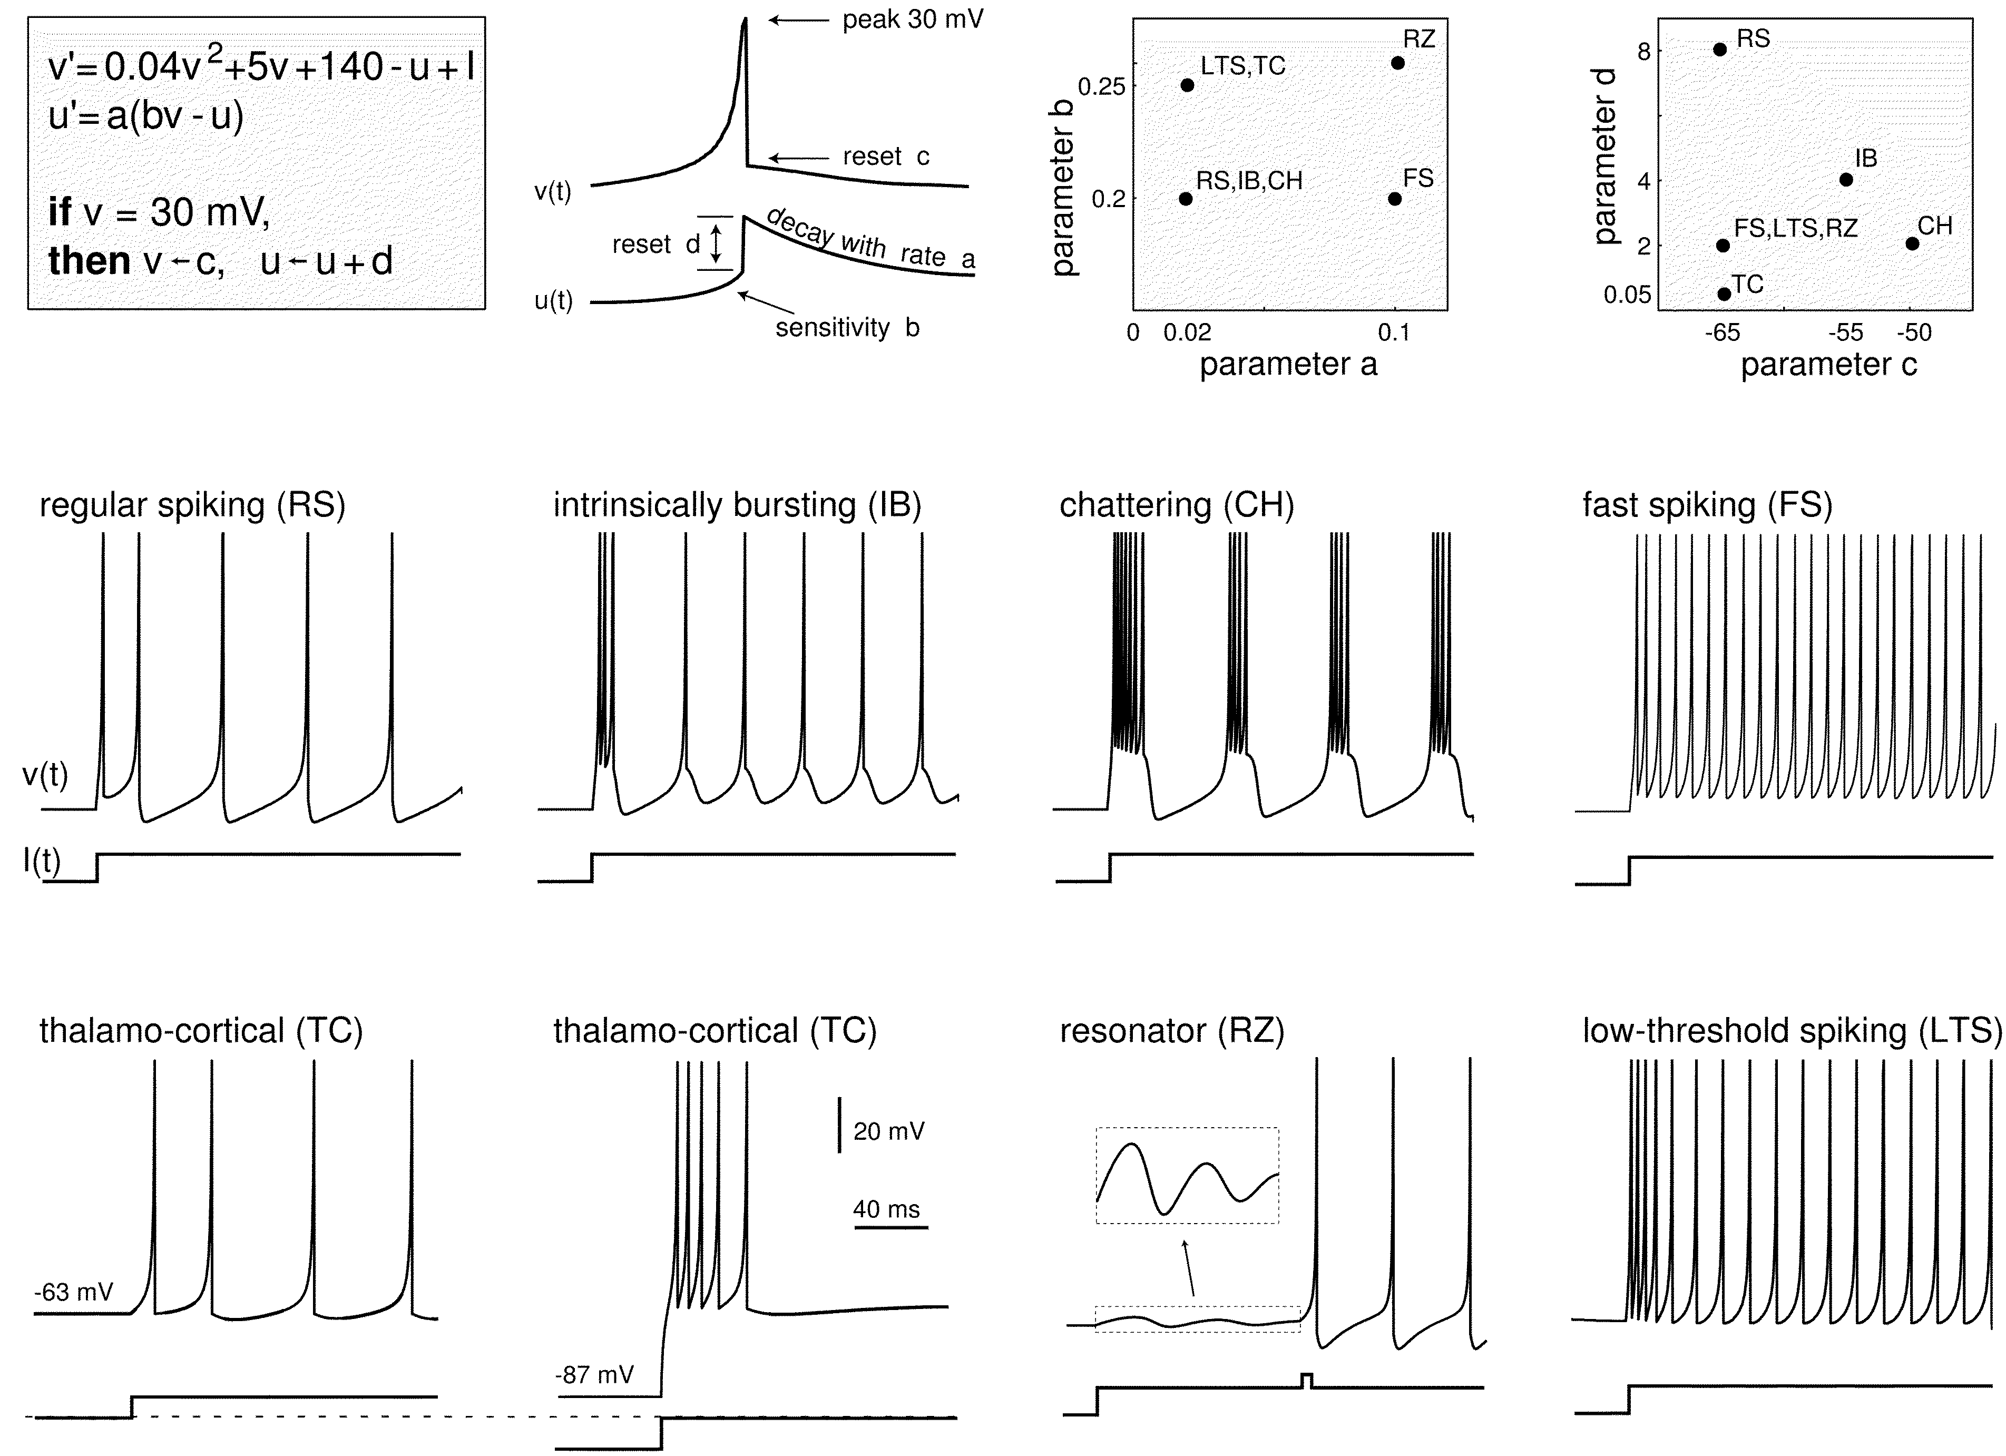
Izhikevich model
Differential equations with threshold and reset
Simple system for exploring two-dimensional dynamics
Provides dynamic degrees of freedom not seen in LIF neurons used in previous LSM work
The Izhikevich model can replicate common spiking patterns with the appropriate choice of parameters (Izhikevich 2003)

Slide 10
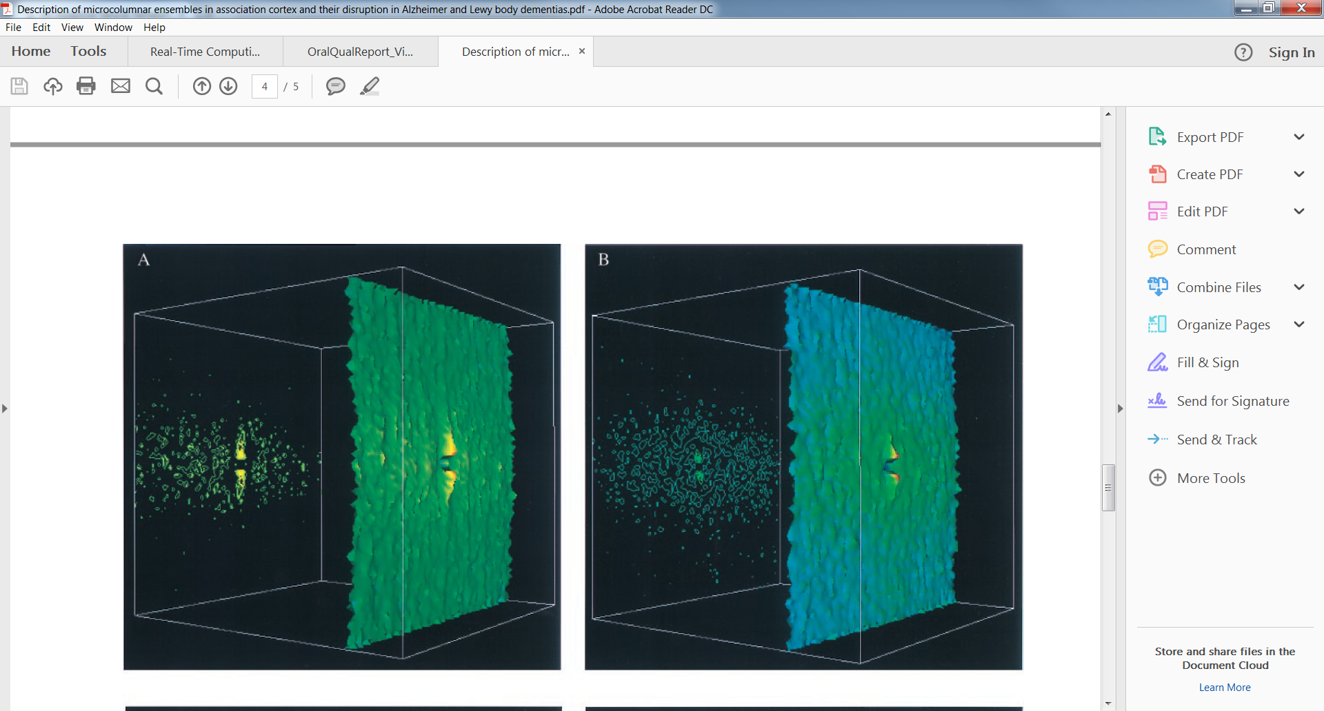
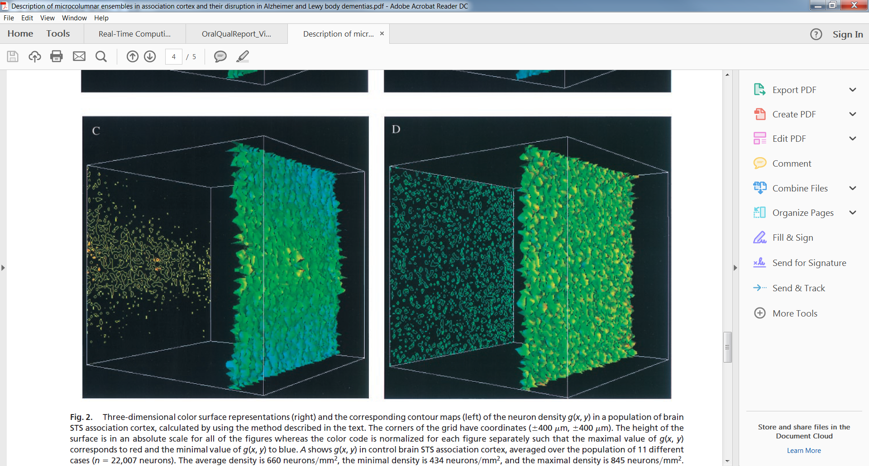
Spatial organization
Several types of spatial organization in the brain, including layered structure in the neocortex
Cortical column structures are oriented across these layers and show preferential connection within the columns
Our group has explored microcolumn structures ~1 neuron thick, there is a correlation between the loss of this organization and cognitive decline
Neuron density maps showing microcolumnar structure in a control sample (A) compared to a randomly generated distribution (D) [Buldreyan 2000]

Slide 11
Results

Slide 12
Problem
Simulated a small neural column
MATLAB model
Izhikevich dynamics, extended to support action potential propagation times
Column structure based on Maas
Distance-dependent connectivity based on Maas
Demonstrated that neural model with delays retains basic properties of Izhikevich model
Demonstrated that distance-dependent delays can be a critical parameter in synchronized firing
Showed that the propagation speed of a population “wave” depends on the width of the neural column
Showed that the neural circuit dynamics encode information about the input spike trains

Slide 13
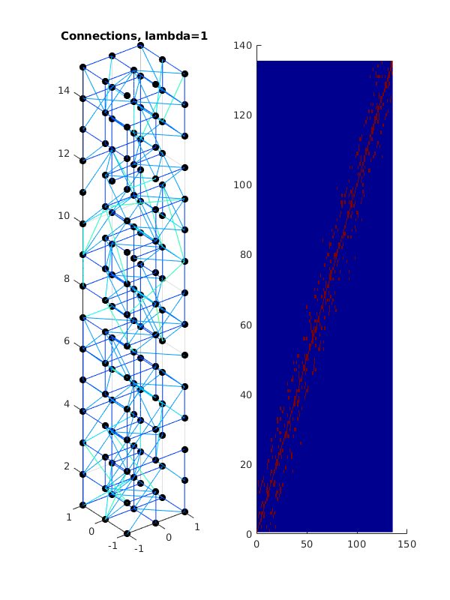
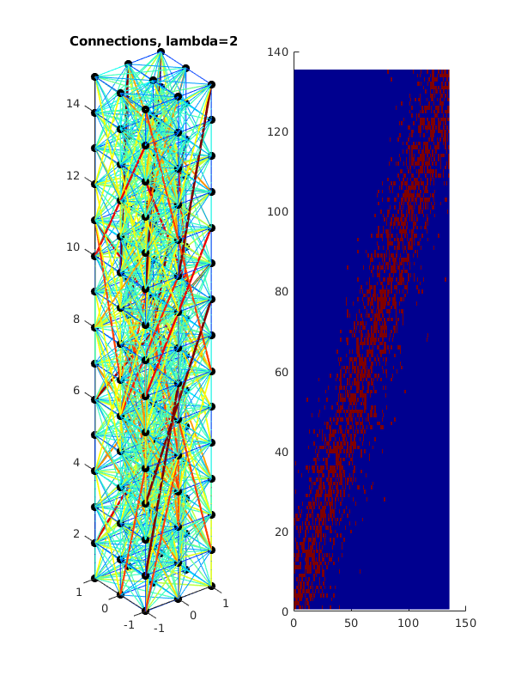
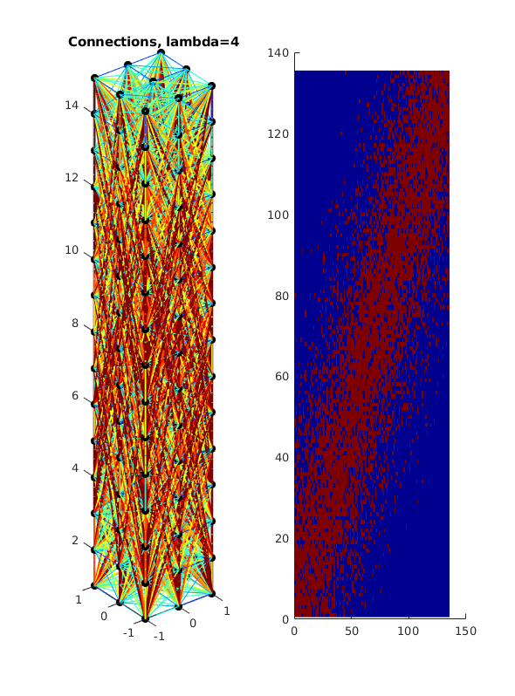
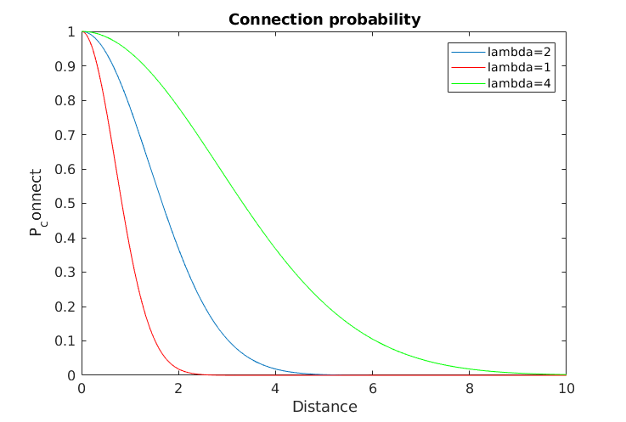
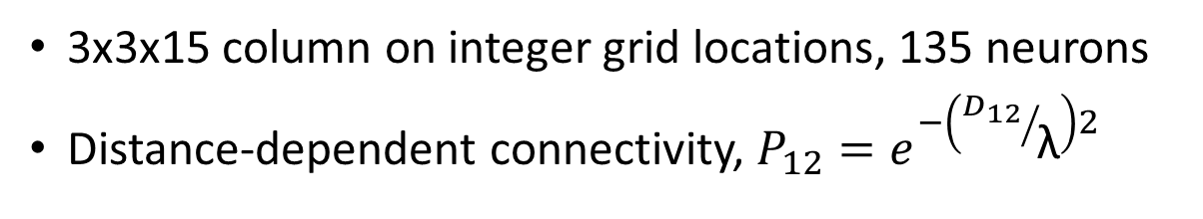
Column model
3x3x15 column on integer grid locations, 135 neurons
Distance-dependent connectivity, $P_{12}=e^{−\left({D_{12}}/{\text{λ}}\right)2}$

Slide 14
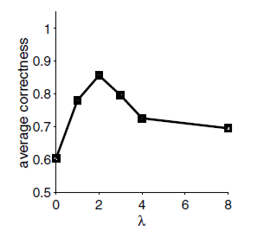
Neural connectivity
Original LSM paper (Maas 2002) found best performance for λ=2
This work will explore how spatial organization and connectivity of the columns effect performance
The liquid neural network performed best with a mix of local and global connectivity (Maas 2002)

Slide 15
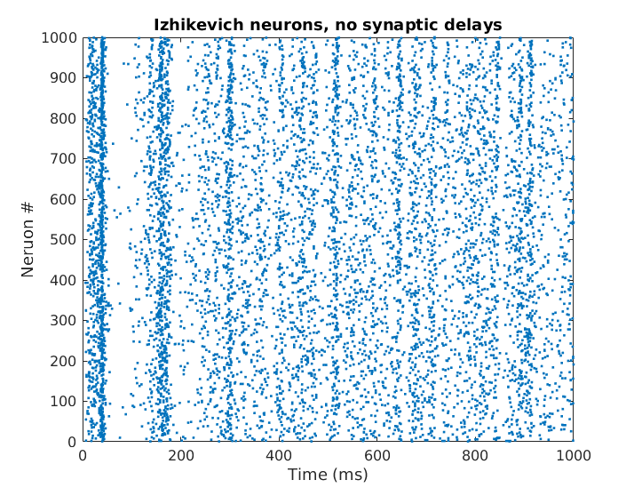
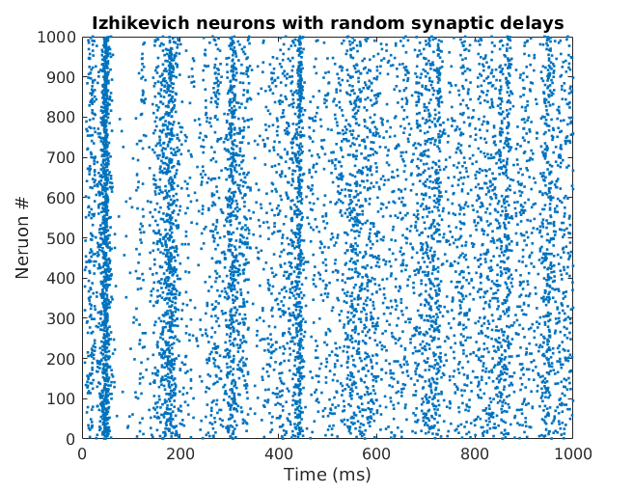
Neural models
Original LSM set all propagation delays to 1.5 ms regardless of position
We extended Izhikevich simulation to include propagation delay
Our model retains basic behavior of the Izhikevich model
The original Izhikevich model (left) and our extended model with random delays (right) both show synchronization in response to randomized “thalamic” input (Izhikevich 2003, https://www.izhikevich.org/publications/spikes.htm)

Slide 16
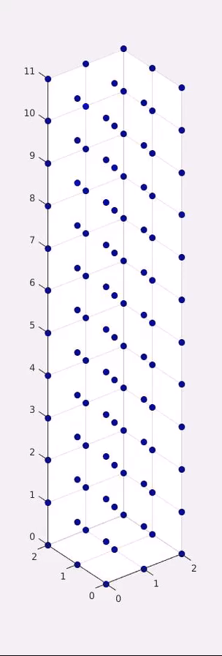
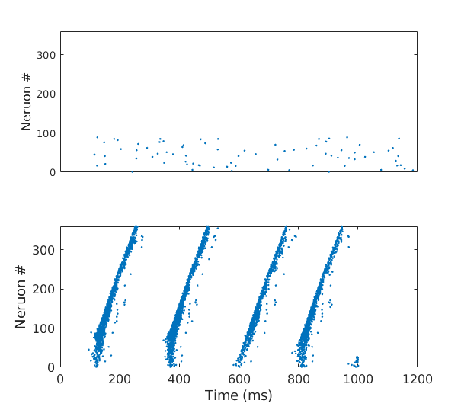
Delay-induced synchronization
Stimulated neurons in bottom 25% with random background, observed wavelike propagation up the column
Demonstrated that the distance-dependent delay can be a critical parameter for synchronized firing with propagation
Column with random propagation delays, no synchronized firing
Identical column with distance-dependent delays, we see synchronized firing that propagates up the column

Slide 17
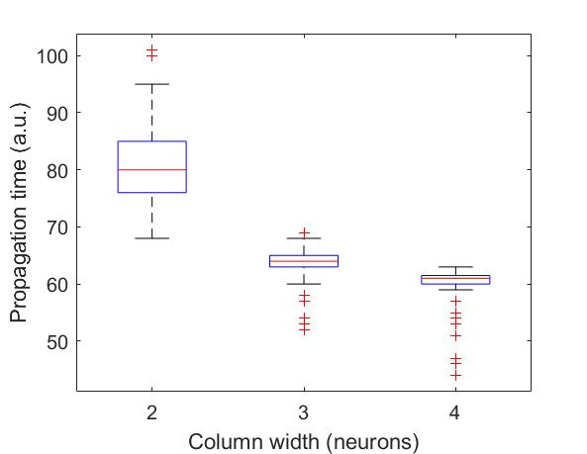
Propagation velocity
Propagating waves in neural circuits have been proposed as a mechanism for neural synchronization (Keane and Gong)
Neural column width affects effective propagation speed
Our group (J. Tumulty) has shown interesting synchronization phases in realistic neural networks with artificially slow propagation
Waves in a two-dimensional neural network (Keane and Gong 2015)
Thinner columns exhibit slower effective propagation speed

Slide 18
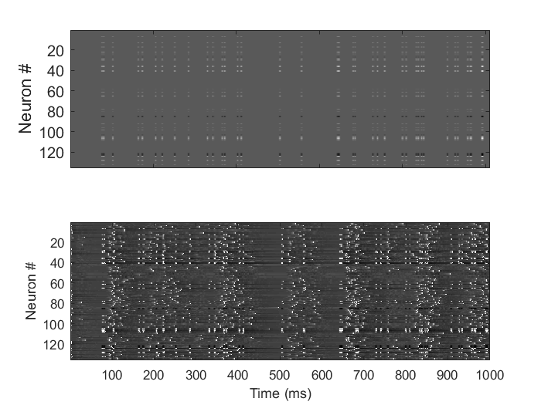
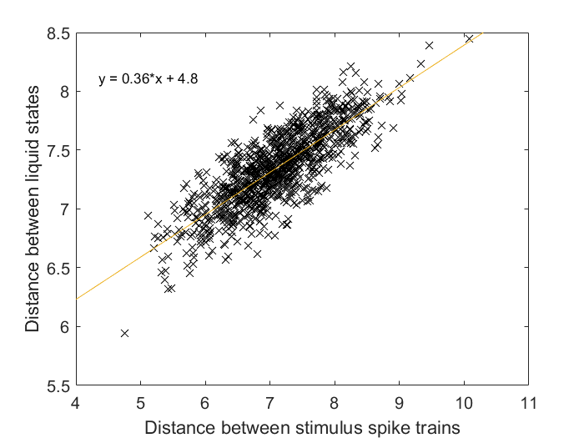
Liquid state distance
Injected pairs of Poisson spike trains, measured spike train distance and liquid state distance using L2 norm
Spikes injected onto 30% of the neurons chosen at random with Gaussian-distributed synaptic strengths
(A)
(B)
Typical stimulus (A) and reservoir response (B)
The distance between the input spike trains is reflected in the reservoir response

Slide 19
Directions for future research

Slide 20
Further work
LSM classifier based on current column model
Speech classifier based on TI46 speech corpus
Commercial data sets
Further dynamics investigations
Neuron dynamics, especially delayed firing near a bifurcation for slow propagation
Spatial organization effect, especially microcolumn structures
Highly realistic simulation
NEURON simulator with validated biological parameters
Efficient hardware implementation of LSM
Concepts for application-specific integrated circuits
Photonic implementation (Prucnal group at Princeton)

Slide 21
References
[1] S. V. Buldyren et al. “Description of microcolumnar ensembles in association cortex and their disruption in Alzheimer and Lewy body dementias".
In: Proceedings of the National Academy of Sciences, 97.10 (2000).
[2] Izhikevich MATLAB simulation. url: https://www.izhikevich.org/publications/net.m.
[3] E. Izhikevich. “Simple Model of Spiking Neuron". In: IEEE Transactions on Neural Networks 14 (2003).
[4] Eugene Izhikevich. Dynamical Systems in Neuroscience. MIT Press, 2007.
[5] Adam Keane and Pulin Gong. “Propagating Waves Can Explain Irregular Neural Dynamics". In: Journal of Neuroscience 35.4 (2015).
[6] Thomas Kreuz et al. “Monitoring spike train synchrony". In: Journal of Neurophysiology 109 (2012).
[7] Wolfgang Maas and Henry Markram. “Real-time Computing Without Stable States: A New Framework for Neural Computation Based on Perturbations".
In: Neural Computation 14 (2002).
[8] Henry Markram, Yun Wang, and Misha Tsodyks. “Differential signaling via the same axon of neocortical pyramidal neurons".
In: Proceedings of the National Academy of Sciences, 95 (1998).
[9] The p-delta rule for parallel perceptrons. url: http://www.igi.TUGraz.at/maass/p%20delta%20learning.pdf.
[10] Y. Zhang et al. “A Digital Liquid State Machine With Biologically Inspired Learning and Its Application to Speech Recognition".
In: IEEE Transactions on Neural Networks and Learning Systems 26.11 (2015).

